Slide 1




EMPOWERING EXCELLENCE, ENSURING QUALITY
EMPOWERING EXCELLENCE, ENSURING QUALITY​

Slide 2
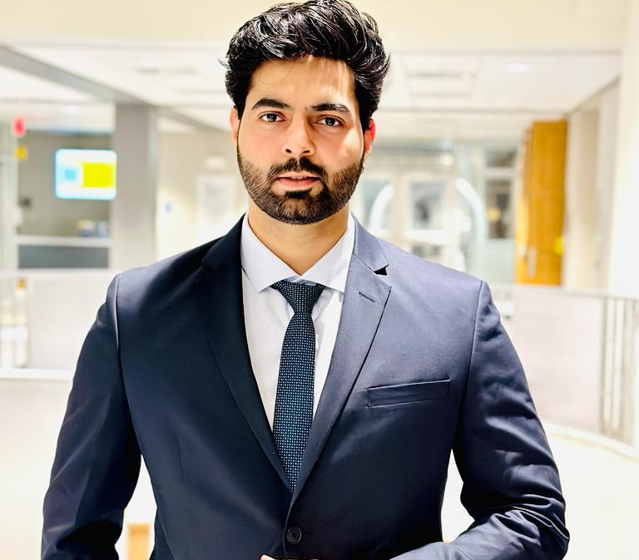

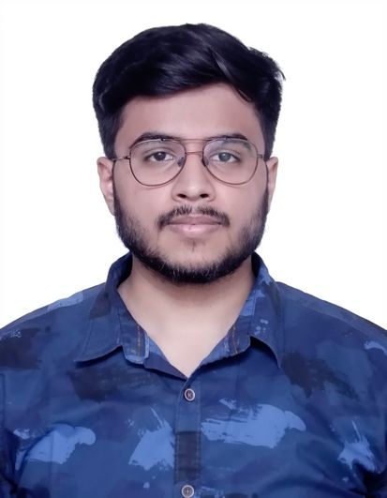

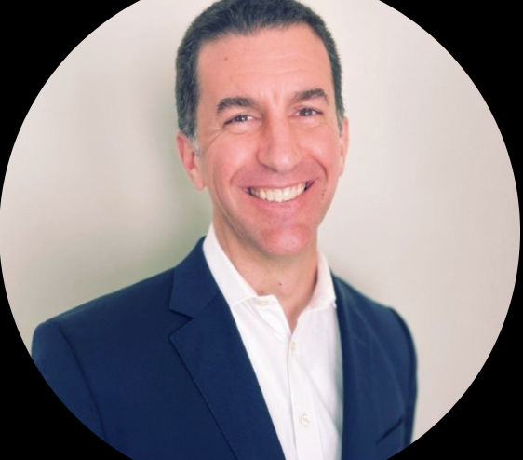
Company Profile
Piyush Bhardwaj
CEO
QualityCareHub's mission is to empower nursing staff with advanced tools for quality care, compliance, and efficiency while envisioning leadership in healthcare training and fostering a culture of excellence.
Sankalp Saoji
COO
Unique Value Proposition:
QualityCareHub's innovative use of a large language model(LLM) streamlines training and quality management, enhancing efficiency and engagement in skilled nursing facilities.
Dhaval Garg
Solution Architect
Apoorv Sharma
CTO
Advisor
Healthcare Technology & Operations Leader
VP, Healthcare Technology, Vayyar Imaging.

Slide 3
Problem Statement
Low-Tech Solutions in Healthcare Facilities.
This leads to inefficiencies, outdated practices, and a lack of engagement among the nursing staff.
Limited Solutions for Survey Preparation and Quality Management
This gap results in a market demand for a more holistic and integrated approach to address these
crucial aspects.
High Turnover and Knowledge Management Challenge
This results in a knowledge management challenge, making it difficult to maintain consistent
quality and compliance.

Slide 4

Solution
Advanced Learning and Knowledge Management with LLM.
Comprehensive Survey Preparation and Quality Management.
Efficient Onboarding and Reduced Dependency.
Utilize data analytics for the creation of a robust and targeted training curriculum.

Slide 5
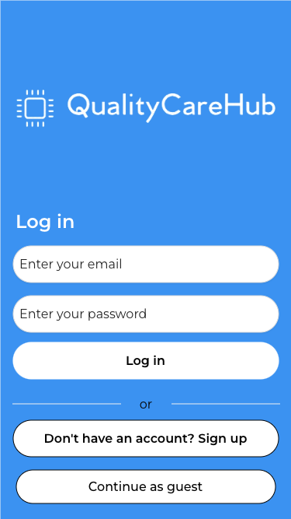
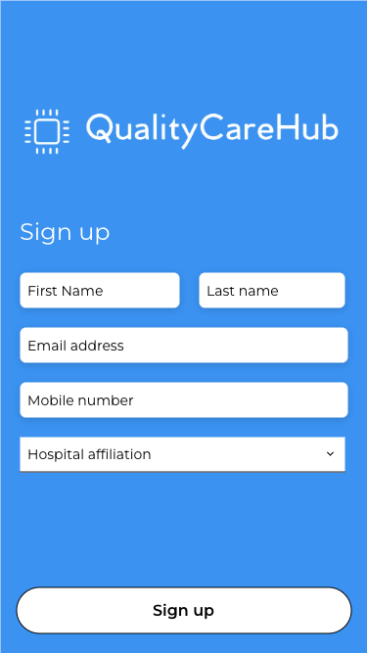
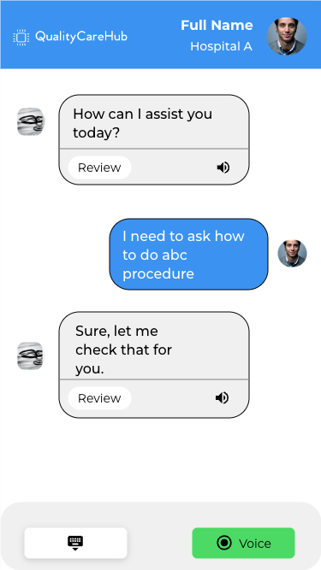
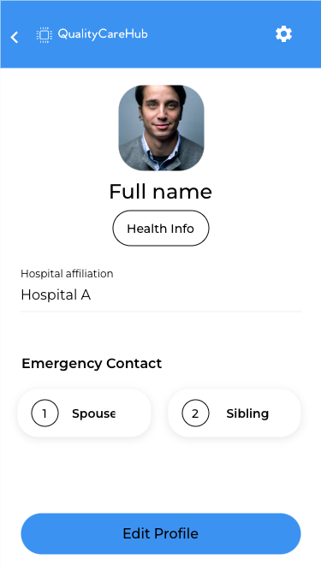
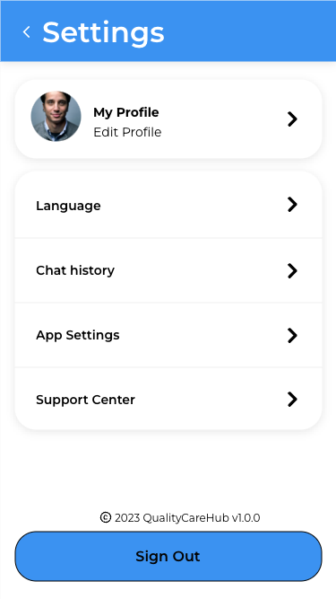
User Interface

Slide 6
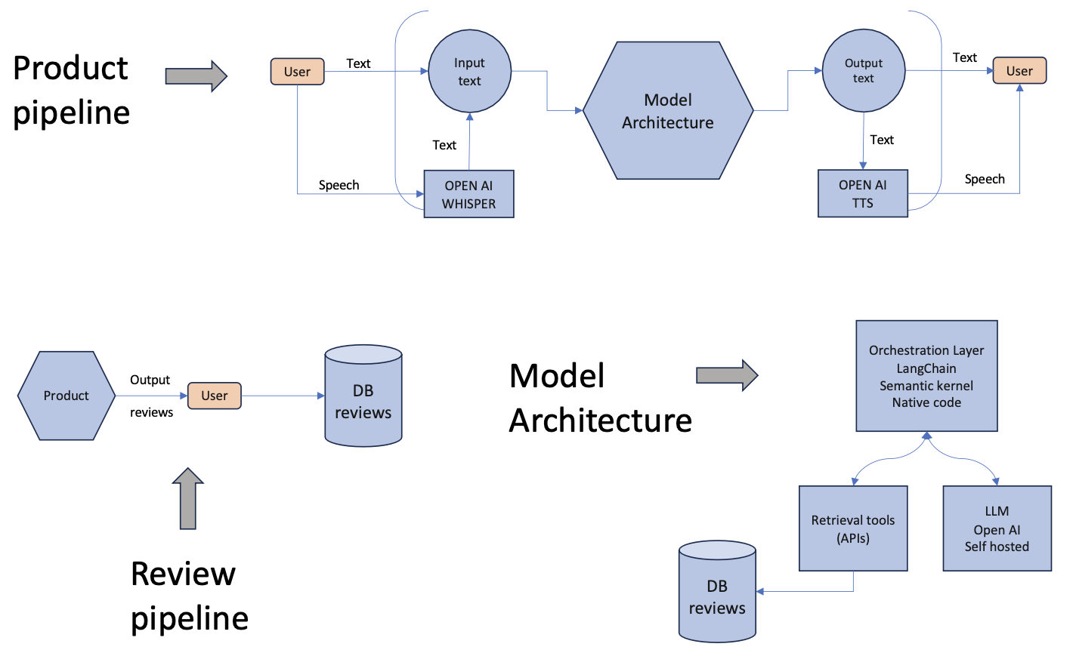
System Design Architecture
Fine-tuned LLM model based on user's hospital affiliation
LLM's input and output will have audio functionality as well
Reviews given by user are used to update the databases

Slide 7
UI Demo
Product
Best practices
Data privacy
Security compliance (HIPAA/SOC2)
Feedback during trial phase
Feature for anonymous login

Slide 8

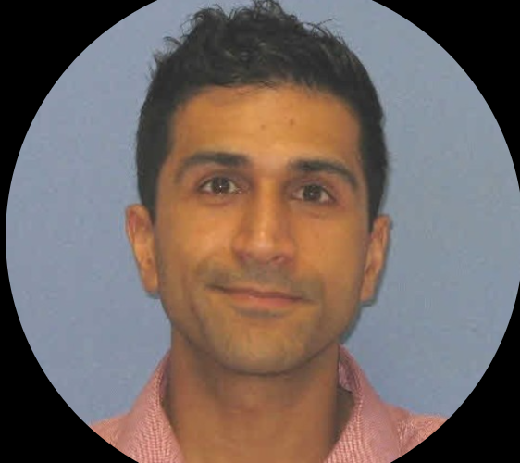
Customer Discovery
Dolly Maiti
Clinical Research Assistant, Mayo Clinic
Shahid Karim, MD
Cardiologist Consultant, Mayo Clinic
"I love how QualityCareHub's training is tailored to our facility's specific needs. The interactive feedback system will allow us to pinpoint gaps in our knowledge, ensuring we get the targeted training we need to deliver quality patient care."
"The large language model is a game-changer! It will not only streamline our training process but will also provide quick and precise answers to our specific questions.”

Slide 9
Customers
Healthcare Institutions
Clinical Staff
Assisted living communities
Skilled Nursing Facilities

Slide 10
Market Size
TAM
$5.3 Bn
Total Addressable Market
Home Care, Assisted living care.
1.2M beds, 18700 SNFs, 30,600 ALC
14.3M adults over age 65
SAM
$600M
Service Addressable Market
SERVICE ADDRESSABLE MARKET
18700 active SNFs
SOM
$55 M - $110 M
Service Obtainable Market
5.5M Registered Nurses in the US.

Slide 11
Value Proposition
Instant Expertise:
Access instant, expert-level support through Large Language Models, empowering nurses with real-time information at their fingertips.
Tailored Training:
Specialized training modules designed for non-technical nursing professionals, ensuring they stay abreast of emerging technologies and quality measures.
Efficient Decision-Making:
Streamlined decision-making processes, reducing time spent on uncertainties and enabling nurses to focus more on patient care.
Strategic Partnerships:
Opportunities for strategic partnerships, offering institutions and tech providers a chance to shape the future of nursing excellence.

Slide 12



Competition
​ | Training Efficiency​ | Quality Management​ | Knowledge Accessibility​ | User Engagement​ | Price​
QualityCareHub​ | High​ | Comprehensive​ | Instant Access​ | Dynamic Learning​ | Competitive​
HealthStream​ | Low​ | Comprehensive​ | Limited​ | Low​ | High​
Generic Healthcare Software​ | Moderate​ | Varied​ | Varied​ | Varied​ | Varied​
In-house Programs​ | Varied​ | Facility-specific​ | Varied​ | Varied​ | Varied​
Abaqis | High​ | Low​ | Moderate​ | Very Low​ | Moderate​
Relias​ | Moderate​ | Low​ | High​ | Very Low​ | Competitive​

Slide 13


Business Model
Revenue Streams
B2B
Business to Business (B2B):
Targeting healthcare organizations, skilled
nursing facilities, and senior living
providers
Subscription Model:
Basic Access: $5/nurse/month (Standard LMS access).
Premium Access: Additional $2/nurse/month (Ad-Free, Priority Support, Enhanced Analytics).
Licensing Fees:
Customized modules or solutions tailored to specific client needs
Supply Chain
Raw Materials:
Knowledge content, data storage, and platform infrastructure.
Components:
Learning modules, analytics tools, customer support services.
Product Distribution:
Online Delivery:
Accessible via web or mobile platforms.
Client Onboarding:
Assisted setup and training during the subscription initiation.
Knowledge Content Providers:
Subject matter experts, healthcare professionals.
Unique Selling Proposition
Premium Features: Ad-Free, Priority Support, Enhanced Analytics.
Customization: Tailored solutions for specific client needs.

Slide 14
Marketing/ Sales Plan
Marketing
Sales Plan
Freemium Model
Conferences
Example: Leading Edge Conference
Introduce a freemium model, allowing potential customers to experience a limited version of QualityCareHub for free.
Connecting with NGOs
Example. National Investment Centre
Referral Programs
Implement a referral program encouraging existing users to refer QualityCareHub to other healthcare facilities. Provide incentives such as extended trial periods, discounts, or exclusive features for successful referrals.
Argentum

Slide 15
Next Steps
In background:
Optimize Marketing strategies
Beta Version
Freemium Version
Hire Certified Nurses
CAN, LPN, RN, NP,LNHA
Monitored by experts
To train the model
Feedback Loop Optimization
Analytics Implementation
Integration with existing (LMS)
Diversify Revenue Streams

Slide 16
The “Ask”
40%
35%
15%
We are seeking an initial funding injection of $200K to kickstart the development.
10% of Funds: Backup
Resources for LLM
Hiring Nurses, Engineers
Marketing

Slide 17


Additional Team Members
Director of Nursing – could be you?
Clinical Advisor – could be you?

Slide 18

Thank You!

